Slide 1

Spaced Repetition based Adaptive
E-learning framework
Group No. 11
Neelay Umrotkar - 16104041
Varun Godambe - 17104040
Amit Kharwal - 17104045
Guided by:
Dr. Uttam Kolekar
Prof. Vishal Badgujar

Slide 2
Contents
Introduction
Objectives
Problem Definition
Technological Stack
Review Suggestions (Given in Last meeting)
Proposed System Architecture/Working
Prototype Design Demonstration
Implementation Status
Status of Paper Draft & Targeted Conference

Slide 3
Introduction
When it comes to academics, memorization is a big part of the system.
Often times, students find it more difficult to memorize information. This results in the students not retaining the information effectively in the long term.
This is where our project idea comes in. We plan to make use of 2 emerging methodologies that help us memorize and retain information better in the long term.
These are:
Spaced Repetition: This helps in retaining information efficiently.
Adaptive Learning: This will help us make the process of learning personalized.

Slide 4
Objectives
We have identified the following as our project objectives:
To design an adaptive algorithm that takes user performance into account in order to adapt the next question’s levels.
To design a space repetition algorithm that takes user’s specific quiz performance into account.
To integrate Adaptive and Spaced repetition algorithms for the proposed system.
To use flashcards for gamification of the learning process.
To create a cross-platform application interface.

Slide 5
Problem Definition
Problem Identified :
    Learning is a lot of the times based on memorization. This can be especially difficult for people to achieve easily and leads to cramming and other ineffective short-term methods which can damage the learning process and are generally ineffective.
Solution Proposed :
    A tool that helps learning become not only efficient but also fun.

Slide 6
Technological Stack
Frontend: React Js.
Backend: Node Js.
Mobile Cross-platform: Flutter.

Slide 7
Review Suggestions
Reframing the objectives such that they are in the format of technical goals.
Cross Platform Support (To be done using Flutter).
Implemented adaptive learning demonstration in the previous XD prototype.
Finalized spacing algorithm based on Ebbinghaus.

Slide 8
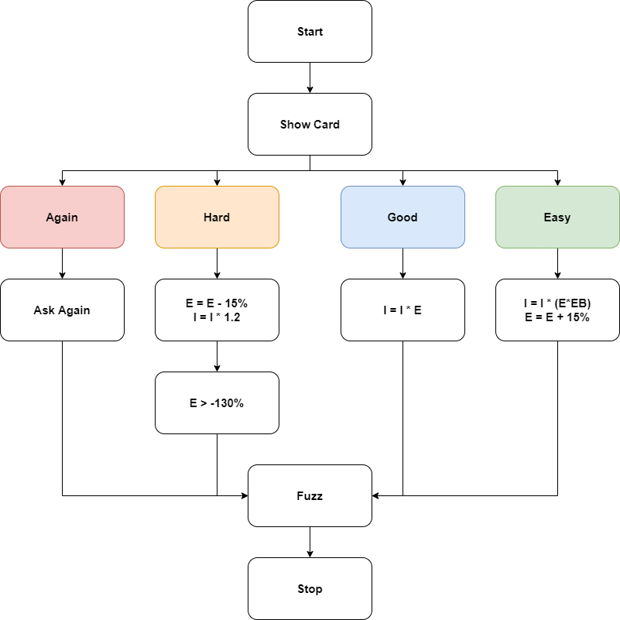
Proposed System Architecture
Architecture Diagram:

Slide 9
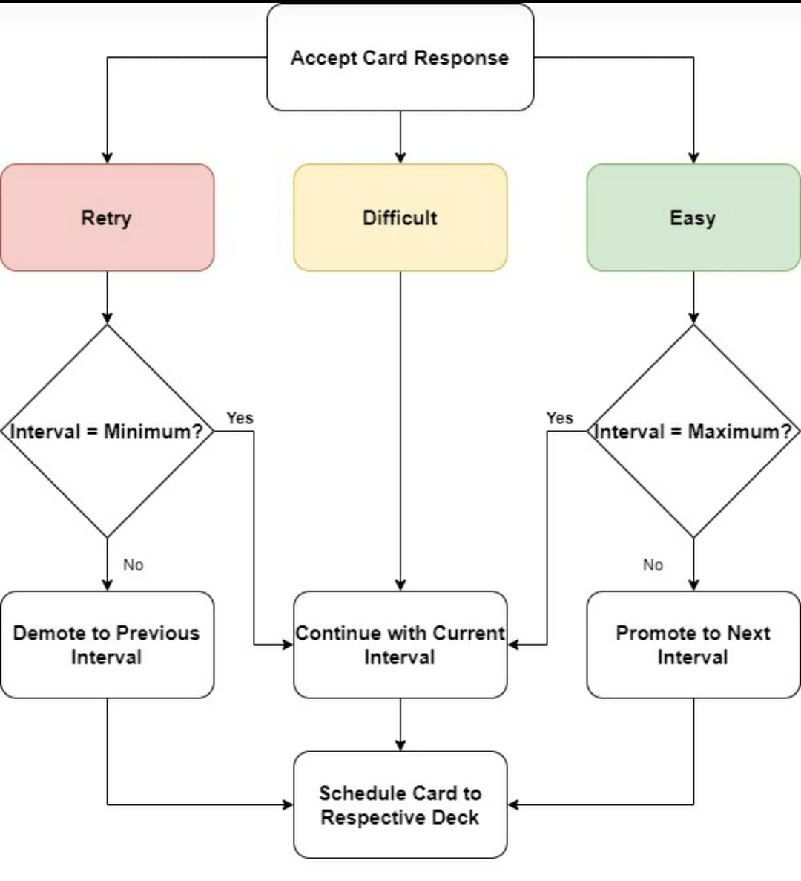
Interval Calculation Diagram

Slide 10
Prototype Design Demonstration
Application Prototype on Adobe XD

Slide 11
Implementation Status
Interface for Login and Signup with Profile completed, complete UI expected by mid/end November 2021.
Flash Card UI in progress.
Algorithm for Spaced Repetition and Adaptive learning ready, pending integration.
Json file for question dump ready, pending integration with UI.
Calendar integration under review.

Slide 12
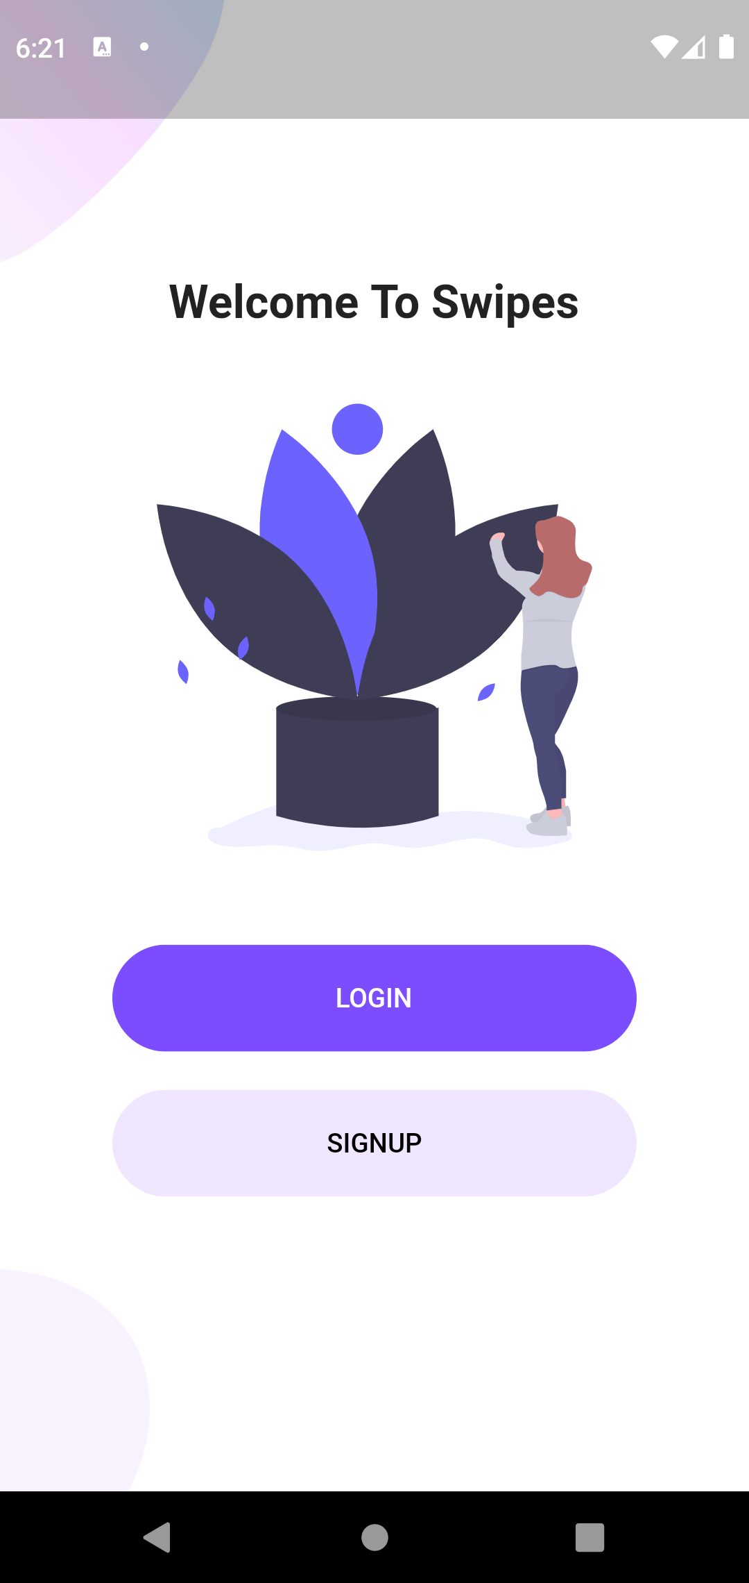
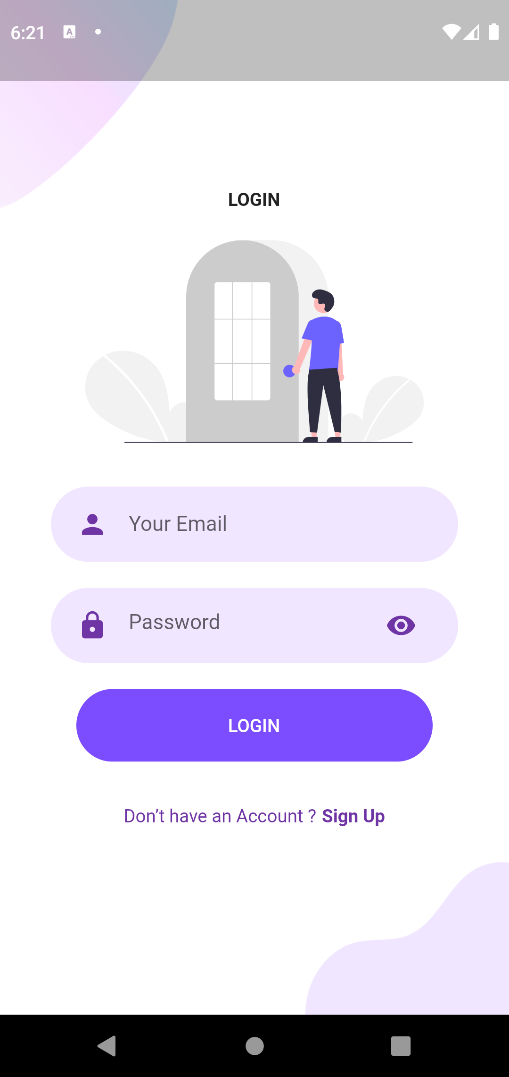
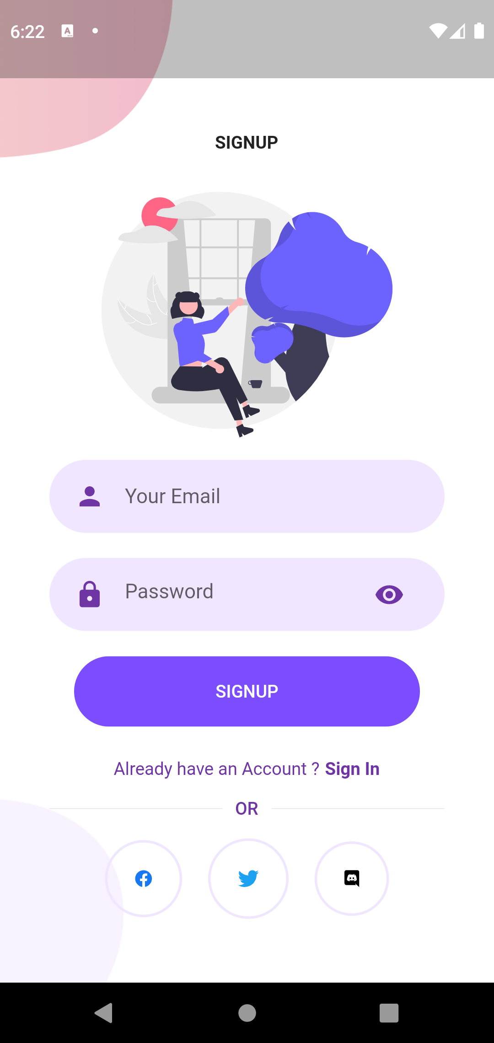
Implementation Status
Login and Signup

Slide 13
Status of Paper Draft and Targeted Conference
Paper completed, approved by guide and submitted in following conferences:
International Conference on Big Data, Machine Learning, and Applications (BigDML 2021): http://bigdml.nits.ac.in/
3rd International Conference on Advances in Distributed Computing and Machine Learning: https://www.icadcml.in/
3rd International Conference on Deep Learning, Artificial Intelligence and Robotics: https://icdlair2021.iaasse.org/index.html

